Slide 1
API Management Rise of the planet of the Apps
XXIII EVENTO PORTO.DATA
Sandro Pereira
Microsoft Azure MVP

Slide 2



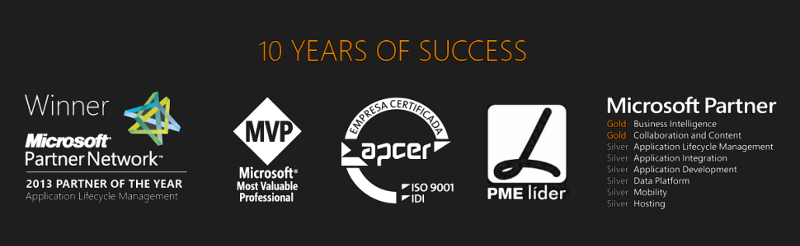



Good afternoon….
Sandro Pereira
Microsoft Azure MVP
sandro.pereira@devscope.net
linkedin.com/in/sandropereira
@sandro_asp
sandroaspbiztalkblog.wordpress.com
+351 223 751 350
www.devscope.net
Notes:
Writer of numerous articles for Portuguese eMagazine “Programar”
Author “Sandro Pereira BizTalk Blog” http://sandroaspbiztalkblog.wordpress.com
Member of “BizTalkAdminsblogging.com” and “BizTalk Brasil” community
Member NetPonto community
MSDN BizTalk Forums Moderator
TechNet Wiki author (Wiki Ninja)
TechNet Gallery, Code Gallery and CodePlex contributor
Public speaker
Technical Reviewer PACKT Publishing
BizTalk Server 2010 Cookbook (April 2012)

Slide 3

Sorry my sport look today…
But is good to be back helping the community after I been in surgery 7 days ago

Slide 4
Agenda
Introduction to Azure API Management
Explain API Management and its value
Show API Management in action

Slide 5
What is an API?
“In the simplest terms, an application programming interface, or API, is a set of requirements that enables one application to talk to another application.” *
* http://readwrite.com/2013/04/24/api-gold-rush

Slide 6

Source Idea from Kent Weare slides http://www.slideshare.net/biztalk360/api-management-part-1-an-introduction-to-azure-api-management

Slide 7
What is a Web API?
Similar in nature but have a prescribed implementation:
HTTP(s)
RESTful
JSON (preferred), XML (supported)
Spec Driven (Swagger, RAML, WADL, API Blueprint)
(ish)

Slide 8
Business of APIs
API Economy
ISVs
New Channels
Marketing & Customer Relationships
API Security
Internal Agility

Slide 9








The rise of APIs
“In the age of the customer, every business is a digital business. This means software is central for today’s enterprises, and APIs are central for today’s software.”
”... APIs play on the frontlines of business opportunity, creating new sources of revenue and market presence; they play behind the scenes, unlocking data and transactions buried in back-office systems; and they play anywhere in between.”
“Sizing The Market For API Management Solutions”
Randy Heffner and Michael Yamnitsky
Forrester Research Inc.
April 2, 2015

Slide 10
The Rise of APIs
Continued robust growth in APIs
Fueled by mobile, cloud, open & big data, IoT
Public APIs are just the “tip of the iceberg”
APIs are a core component for many startups
APIs are drivers of innovation in the enterprises

Slide 11
The Power of APIs
The power of APIs - In 2015
Uber, the world's largest taxi company owns no vehicles
Facebook, the world's most popular media owner creates no content
Alibaba, the most valuable retailer has no inventory
Airbnb, the world's largest accommodation provider owns no real estate
Source: LinkedIn

Slide 12


















Who uses APIs in their Business?
Source from Kent Weare slides: http://www.slideshare.net/biztalk360/api-management-part-1-an-introduction-to-azure-api-management

Slide 13
But…
How do you engage with developers?
How do you reduce TTFSC?
How do you enforce your business policies?
How do you make your legacy API modern?
How do you understand their behavior?
How do you protect your core business systems?
API Management

Slide 14
Extending a platform
let’s talk about apis and how they can boost your business
developers
new channels, more customers
API
…with help from Vince Vaughn
partners
employees

Slide 15


Intern
IT Manager
Source from Kent Weare slides: http://www.slideshare.net/biztalk360/api-management-part-1-an-introduction-to-azure-api-management

Slide 16

I need to ‘mobilize’ our existing systems
We need more channels!
Source from Kent Weare slides: http://www.slideshare.net/biztalk360/api-management-part-1-an-introduction-to-azure-api-management

Slide 17

When we go live with this in 6 weeks. We will leapfrog
the competition and I will get a huge bonus!!!
6 weeks? Try 6 months.
Security?
Enrollment?
Governance?
Visibility?
Source from Kent Weare slides: http://www.slideshare.net/biztalk360/api-management-part-1-an-introduction-to-azure-api-management

Slide 18

#$%&#^% IT is too slow!!!
Amateurs
I should just outsource everything
Source from Kent Weare slides: http://www.slideshare.net/biztalk360/api-management-part-1-an-introduction-to-azure-api-management

Slide 19

I have no idea how we are going to do this. It takes 6 weeks just for change management.
What is API Management?
Source from Kent Weare slides: http://www.slideshare.net/biztalk360/api-management-part-1-an-introduction-to-azure-api-management

Slide 20

This might actually work since I don’t need to get the whole IT Department involved.
Source from Kent Weare slides: http://www.slideshare.net/biztalk360/api-management-part-1-an-introduction-to-azure-api-management

Slide 21

…and we didn’t need to re-write backend services
Source from Kent Weare slides: http://www.slideshare.net/biztalk360/api-management-part-1-an-introduction-to-azure-api-management

Slide 22


Self Service Enrollment
No Firewall Ports need to be opened
Out of Box Authentication
Throttling and Rate Limiting
Caching
Leverage existing investments
Source from Kent Weare slides: http://www.slideshare.net/biztalk360/api-management-part-1-an-introduction-to-azure-api-management

Slide 23

…and we now have analytics so we can track where requests are coming from and drive future investment
Source from Kent Weare slides: http://www.slideshare.net/biztalk360/api-management-part-1-an-introduction-to-azure-api-management

Slide 24

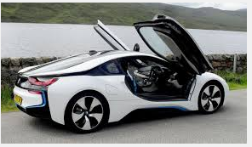
I knew we could do it! Drinks on me.
Source from Kent Weare slides: http://www.slideshare.net/biztalk360/api-management-part-1-an-introduction-to-azure-api-management

Slide 25

What is API Management?
Source from Kent Weare slides: http://www.slideshare.net/biztalk360/api-management-part-1-an-introduction-to-azure-api-management

Slide 26
API Management provide similar services
Development Engagement
Analytics
Authentication and Authorization
Policy Enforcement

Slide 27

Agility
Source idea from Kent Weare slides: http://www.slideshare.net/biztalk360/api-management-part-1-an-introduction-to-azure-api-management

Slide 28
Microsoft Azure API Management life cycle
Azure API MGMT
Project existing or new services as APIs
View Operational and Business insights through Analytics
Developer Engagement
Publish APIs to developers, partners and citizens

Slide 29

Azure API Management
AZURE API MANAGEMENT
Facade
decouple
modernize
optimize
...
Middleware
secure
protect
cache
...
Monitoring
usage
health
monetization
...
Developer
discover
document
on-board
...

Slide 30
Azure API Management
AZURE API MANAGEMENT
Facade
decouple
modernize
optimize
...
Middleware
secure
protect
cache
...
Monitoring
usage
health
monetization
...
Developer
discover
document
on-board
...
APIs on Azure
Azure APIs
On-prem APIs
3rd party APIs

Slide 31
Azure API Management
API consumers
AZURE API MANAGEMENT
Facade
decouple
modernize
optimize
...
Middleware
secure
protect
cache
...
Monitoring
usage
health
monetization
...
Developer
discover
document
on-board
...
APIs on Azure
Azure APIs
On-prem APIs
3rd party APIs

Slide 32



AZURE API
MANAGEMENT
DEVELOPER PORTAL REGISTRATION DOCUMENTATION INTERACTIVE API CONSOLE DEVELOPER ANALYTICS APP GALLERY FORUMS NEWS ISSUES WIKI
APP DEVELOPERS
Developer Portal
API PROXY SCALING CACHING MONITORING
TRAFFIC MANAGEMENT
DIRECT OR
VPN
BACKEND
APIs
APPS
Gateway
ADMIN PORTAL API PUBLISHING SUBSCRIPTION MANAGEMENT SECURITY MEDIATION CONTENT PUBLISHING SITE CUSTOMIZATION ISSUE MANAGEMENT ANALYTICS REPORTS
Hosted anywhere.
Developed using any technology.
API PUBLISHERS
Publisher portal

Slide 33
Why API Management?
Establish a single API “front door”
Build an API façade for existing backend services
Add new capabilities to the APIs, such as response caching
Reliably protect published APIs from misuse and abuse
Package and publish APIs to developers and partners
On-board developers via a self-service portal
Ramp-up developers with docs, samples, and API console
Gain insights into API usage and health from analytics reports

Slide 34
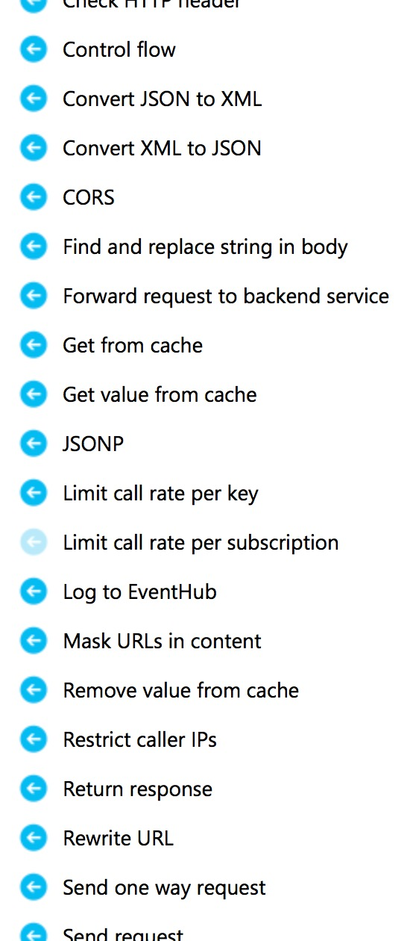
Briefly about policies and expressions
Policies
Encapsulate common API management capabilities
Mutate request context or change API behavior
Can be set in the inbound and outbound directions
Have global, product, API or operation scope
Expressions
C# “snippets” embedded in policies
Have read-only access to the request context
Can use whitelisted .NET types only
Are used to dynamically configure policies

Slide 35



Common scenarios
Mobile enablement
Partner ecosystem
Business agility
Optimize and secure backend
Authorize and throttle requests
Get visibility into usage and health
Drive developer adoption
Modernize legacy backends
Package APIs into tiers
Enforce usage limits
Provide support and receive feedback
Normalize legacy backends
Build the catalog of APIs
Accept organizational ID
Respect org structure

Slide 36









Logic App
Machine Learning
SQL Database
Function
Event Hub
Stream Analytics
Power BI
Data Late Cluster
Data Lake Storage
Stream Analytics
JSON, XML, CSV...
<log-to-eventhub
logger-id=“id”
partition-key=“@(expression)”>
@{expression}
</log-to-eventhub>
BACKEND
SERVICES
AZURE API
MANAGEMENT
APPS

Slide 37
What is API Management?
Demo
API Management

Slide 38
Questions?

Slide 39


Thanks
sandro.pereira@devscope.net
linkedin.com/in/sandropereira
@sandro_asp
sandroaspbiztalkblog.wordpress.com
+351 223 751 350
www.devscope.net

